Slide 1
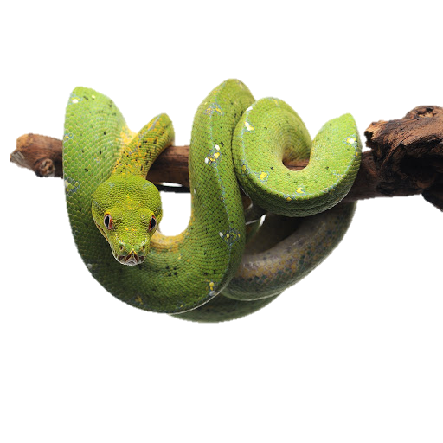
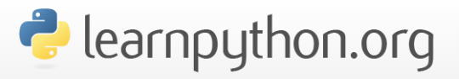
Welcome to Introduction to Python (Part I)
Instructors:

Slide 2
Introduction
Course Objectives
Give biologists comfort and confidence with computation
Basic ability to learn and practice computational skills in your future research
Basic Python Programming
Learn how to use IDLE to execute Python commands and use Wing 101 to write Python scripts

Slide 3
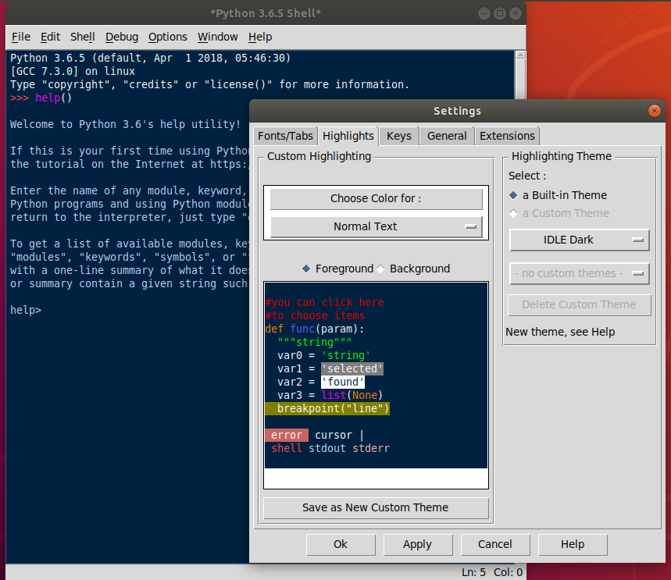
IDLE to execute Python commands

Slide 4
Introduction
Course Objectives
Give biologists comfort and confidence with computation
Basic ability to learn and practice computational skills in your future research
Basic Python Programming
Learn how to use IDLE to execute Python commands and use Wing 101 to write Python scripts

Slide 5
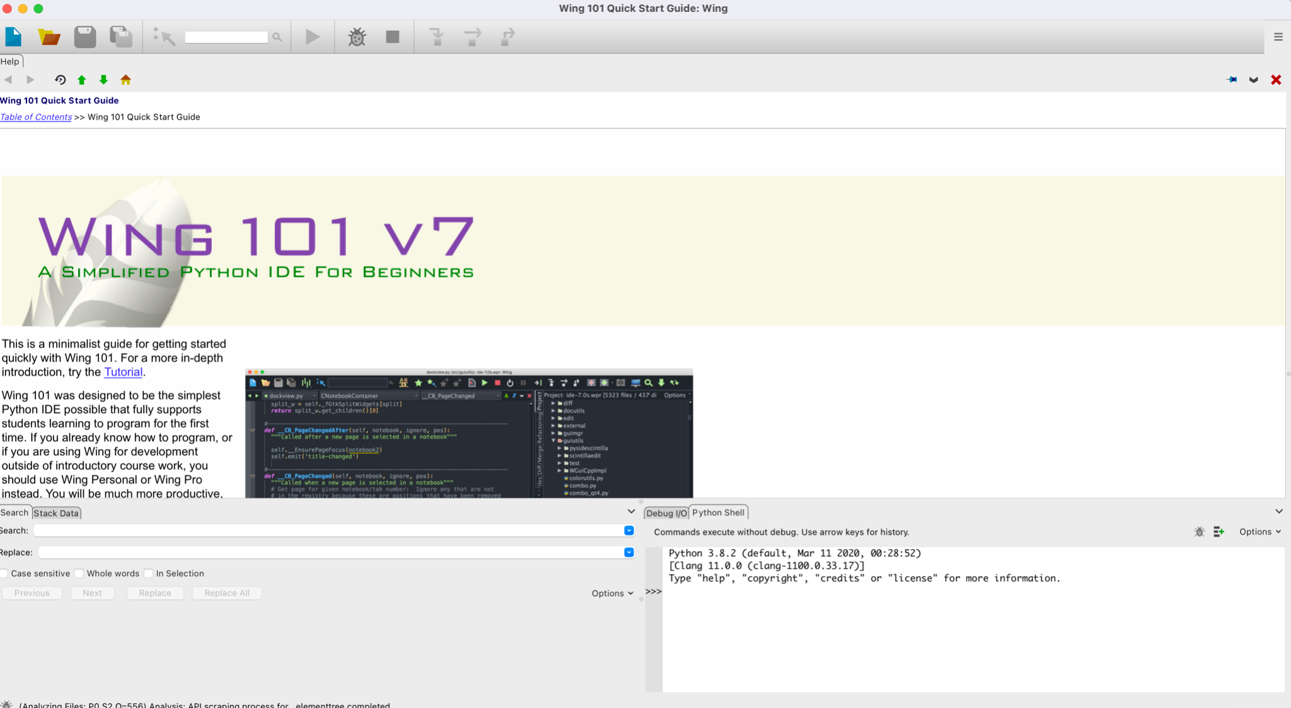
Wing 101 to write Python scripts

Slide 6
Introduction
Course Objectives
Give biologists comfort and confidence with computation
Basic ability to learn and practice computational skills in your future research
Basic Python Programming
Learn how to use IDLE to execute Python commands and use Wing 101 to write Python scripts
Create and manipulate variables
Use loops and conditional statements in a Python program

Slide 7
Introduction
This course is….
A formal introduction to computer science but it is…
This course is NOT….
A systematic course in bioinformatics
A substitute for understanding how the statistics/programs/analyses you use work

Slide 8
Introduction
What you DON’T need to succeed
Deep math background
Previous programming experience
What you DO need to succeed
Logical and organized way of thinking (or at least organized notes for your future self!)
Determination
Practice

Slide 9
Basic Python
Day 1
Day 2
Install Python and Pycharm
Interactive and batch mode
Docstrings and comments
Learn the basics of Python syntax
Variables
Data types
Strings
Review the basics of Python syntax
Variables
Data types
Strings
Gene Sequence Exercise
You don’t need to understand what these mean yet!

Slide 10
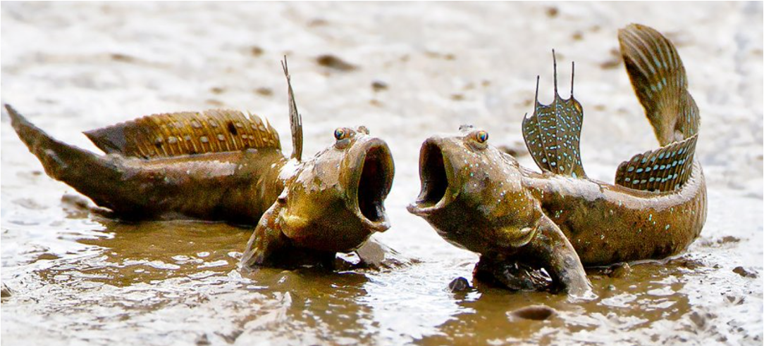
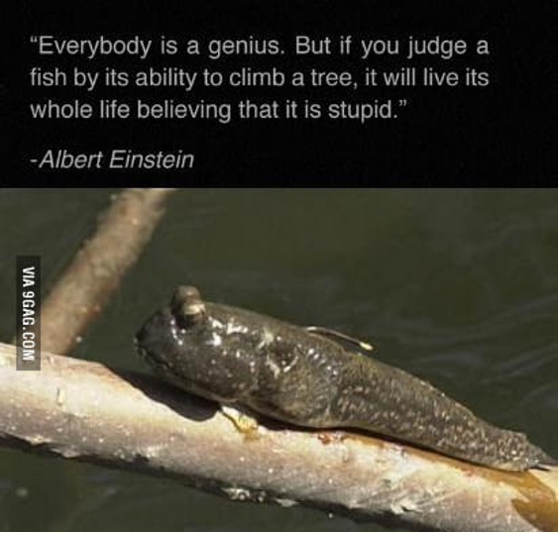
Let’s get started!

Slide 11
Introduction
Am I cut out for Programming?
Programming Skills
Logical thinking
Detail oriented
Able to solve problems based on incorrect results
Biologists are natural programmers!

Slide 12
Introduction
What is a program (script)?
A Detailed Set of Instructions for How to Do Something
Definitions/symbols (assignments)
pi = 3.1416
Actions
Area = pi x radius2
Loops
Repeat 2 times
Repeat until …
Conditional
If (something) do (something)
Results (Output)

Slide 13
Introduction
What is a program (script)?
Can mean several things…
In programming
A program that is interpreted or carried out by another program rather than by a processor
Popular scripting languages:
Python
Perl
Java

Slide 14
Introduction
What is a program (script)?
Computers are Like Very Hard Working but Very Stupid Lab Helpers
Instructions must be exact – computers are quite happy to do the wrong thing over and over
All possible alternatives must be covered – when undefined situations occur computers either
Do the wrong thing
Stop and wait (forever)
Fail catastrophically (starved because they never finished and missed dinner)

Slide 15
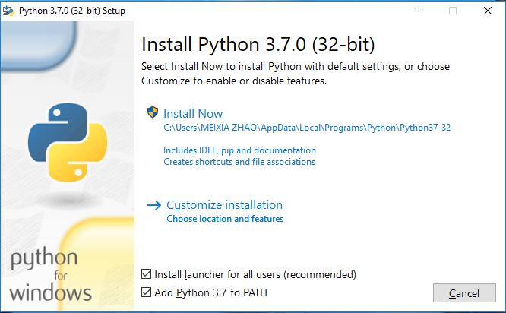
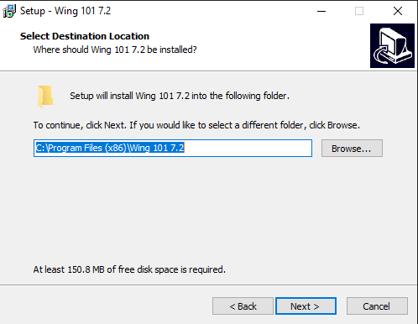
Basic Python
Install Python and Wing 101
Install Python (must be version 3)
Install Wing 101
If run into problems: https://wingware.com/get&prod=wing-101&target=pub/wing-101/7.2.3.0/wing-101-7.2.3.0.exe
Notes:
If run into problems: https://wingware.com/get&prod=wing-101&target=pub/wing-101/7.2.3.0/wing-101-7.2.3.0.exe

Slide 16
Basic Python
IDLE (Integrated Development and Learning Environment)
IDLE is a program used to write and execute Python code
For windows:
Navigate to the Start Menu in the bottom left hand corner of the screen
Type in the search bar IDLE and click on the application IDLE
For Mac:
Open the Finder and type in IDLE in the search menu
You also can open the Applications folder in the Finder and find the IDLE program

Slide 17
IDLE to execute Python commands

Slide 18
Basic Python
Python Programming/Interactive mode
Two Basic Python Modes
Interactive mode (Front-end)
Batch Mode (a script)

Slide 19
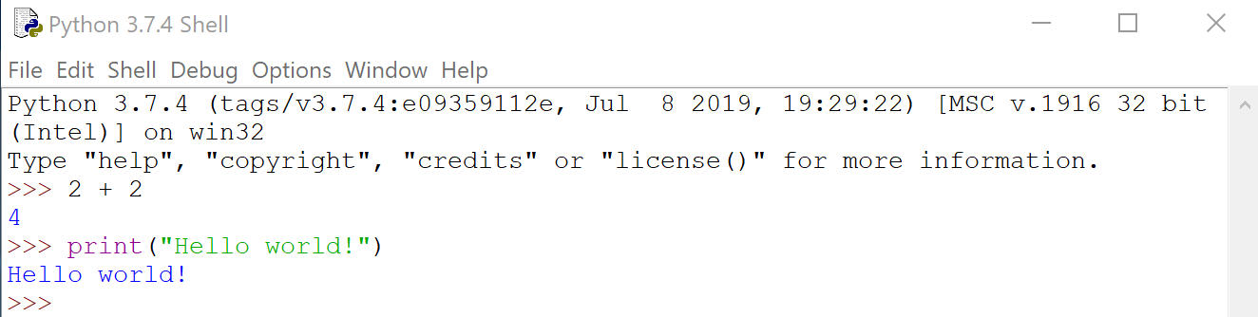
Basic Python
Python Programming/Interactive mode
Two Basic Python Modes
Interactive mode (Front-end)
Interactive mode is a command line shell which gives immediate feedback for each statement
>>> print ('Hello World!')
Hello World!
>>> 1 + 1
2
Notes:
For windows:
Navigate to the Start Menu in the bottom left hand corner of the screen
Type in the search bar IDLE and click on the application IDLE
For Mac:
Open the Finder and type in IDLE in the search menu
You also can open the Applications folder in the Finder and find the IDLE program

Slide 20
Basic Python
Python print( ) function
The print( ) function prints the given object to the standard output device (screen) or to the text stream file.
By default it prints all inputs separated with a whitespace, but you can change the separator with a parameter named sep.
print (objects, sep=' ', end = '\n')
>>> print('Hello', 'World!', sep=‘-')
Hello-World!
>>> print('Hello', 'World!', 'World!', sep='-', end='\n')
Hello-World!-World!

Slide 21
Basic Python
What is a program (script)?
Computers are Like Very Hard Working but Very Stupid Lab Helpers
Instructions must be exact – computers are quite happy to do the wrong thing over and over
All possible alternatives must be covered – when undefined situations occur computers either
Do the wrong thing
Stop and wait (forever)
Fail catastrophically (starved because they never finished and missed dinner)

Slide 22
Basic Python
Python Programming/Batch mode
Two Basic Python Modes
Batch Mode (script)
The Python Shell is convenient for executing a few simple commands. If you need to give the computer more complex instructions, it’s a good idea to write a script. A Python script is a set of instructions that you can easily edit and run.
When a program is executed from such a text file, rather than line by line in an interactive interpreter, it is called batch mode.
1. Go to File >> New File to create a new script.
2. In your script, write print(“Hello!”).
3. Go to File >> Save As… to save your script. Choose a location and a name. Be sure to add .py to the end of the file name. This will save the file as a Python script.
4. Go to Run >> Run Module to run your script. The Python shell will reopen and display Hello!

Slide 23
Basic Python
Python Programming/Batch mode
Two Basic Python Modes
Batch Mode (script)
These are regular text files usually with the “.py” extension. They are also known as python scripts.
These files can be generated with any standard text editor, such as Pycharm, Notepad++, EditPlus, Wing 101 etc.

Slide 24


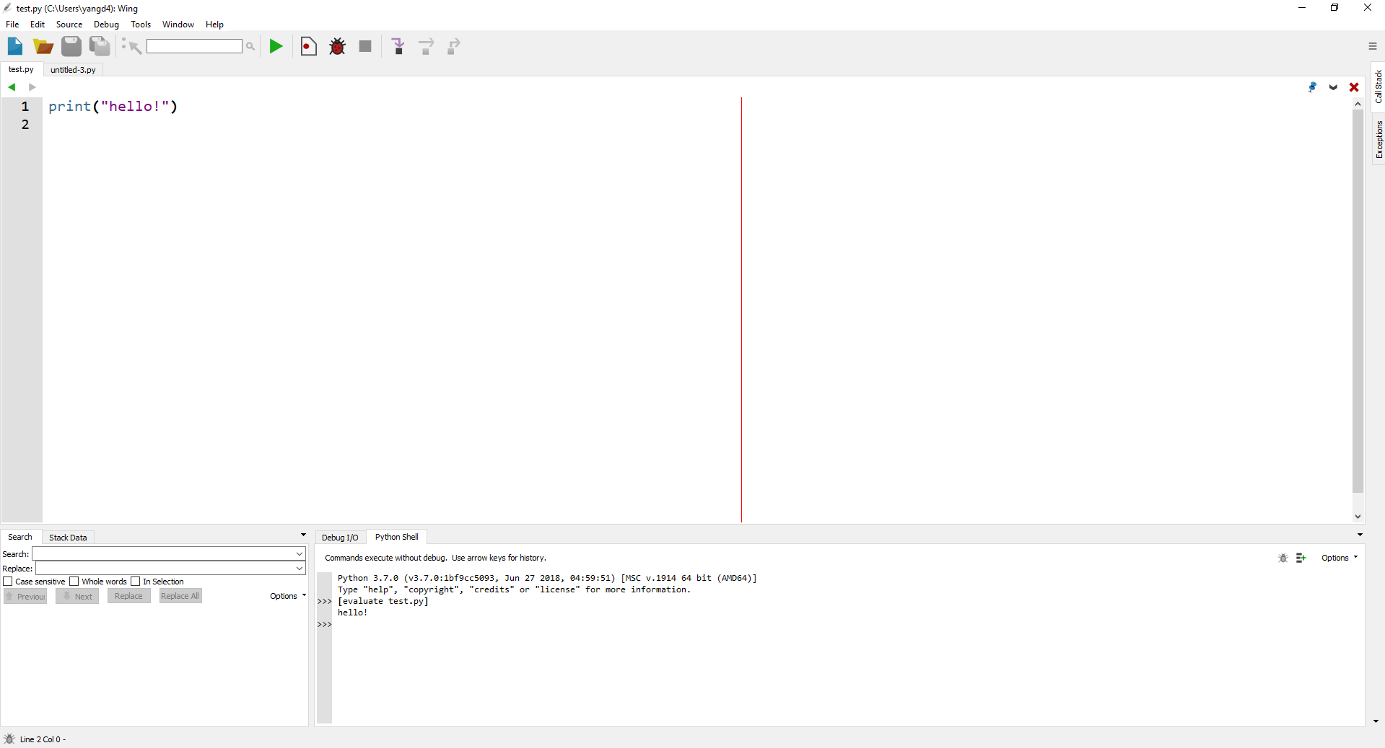
Basic Python
Create a New Project
Click “File” --- “New” (Or click on the button)
Write your code (Eg. print("hello!") )
Click “File” --- “Save as” --- Name your file
Click on the button to run your program
Here is your output!

Slide 25
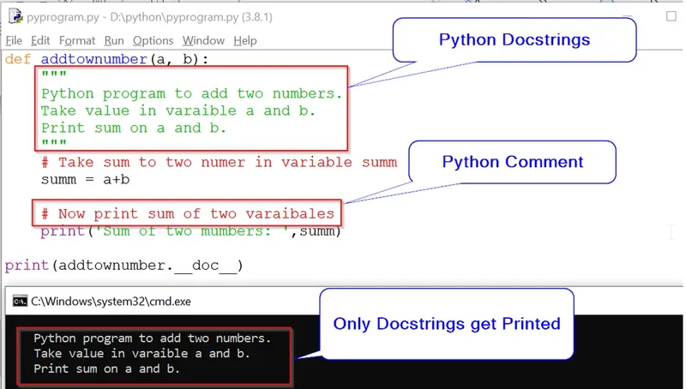
Docstrings and Comments

Slide 26
Basic Python
Docstrings and Comments
Programming Best Practices: Commenting and Clarity
The top priority is making your program easy to understand
Makes it possible to verify correctness
Simplifies modifying and updating
Promotes reuse
Requirements
Docstrings – Block quotes within triple “”” are called docstrings. They are used in the interpreter to provide help. For programs in this course
You must supply a header as a docstring. The header must include
Purpose of the program
Your name
Date
Comments –comments are introduced by #. Use comments to describe the steps in your program.

Slide 27
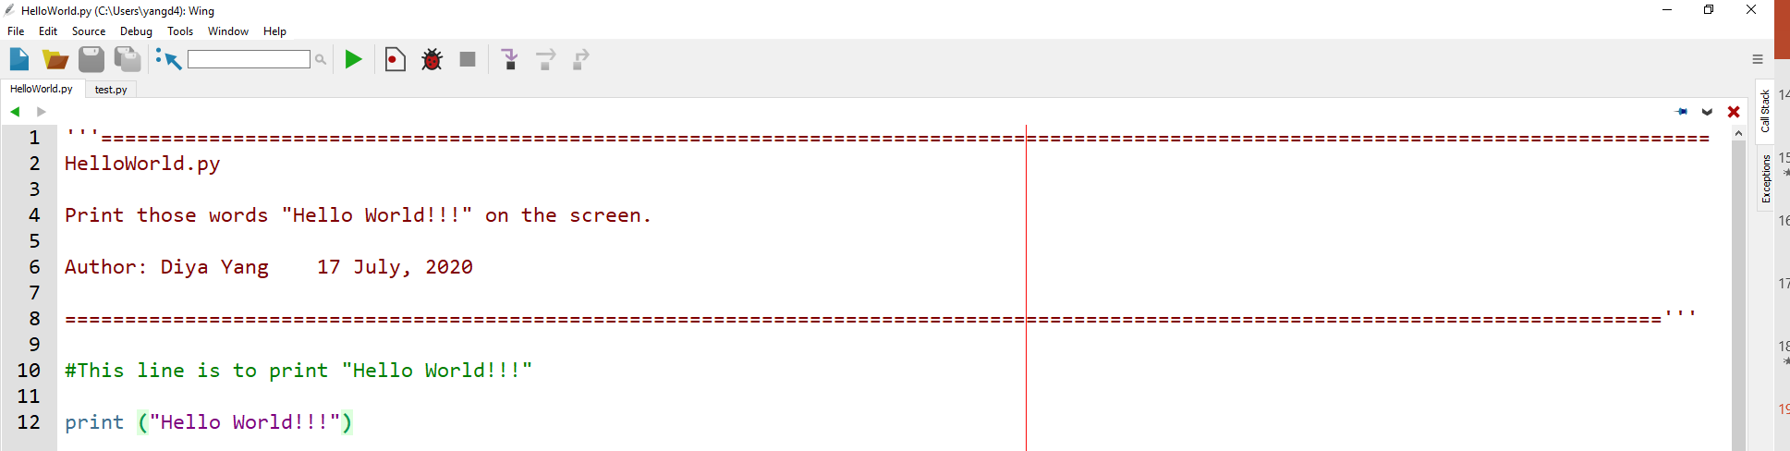
Basic Python
Docstrings and Comments
Programming Best Practices: Commenting and Clarity
The header and comments should be written before you start writing any code
Start with the header
Add comments describing the actions
Only then start programming

Slide 28
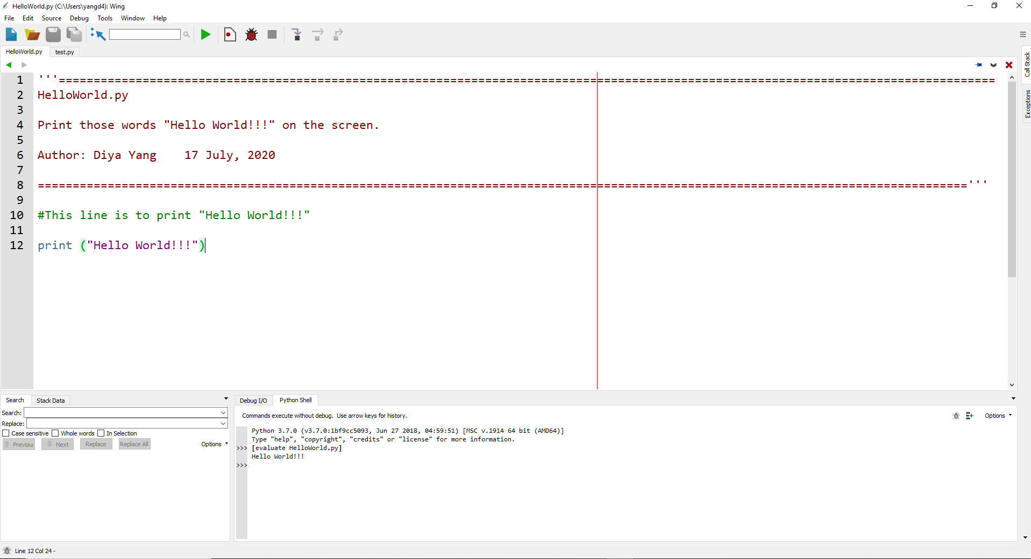
Basic Python
Docstrings and Comments

Slide 29

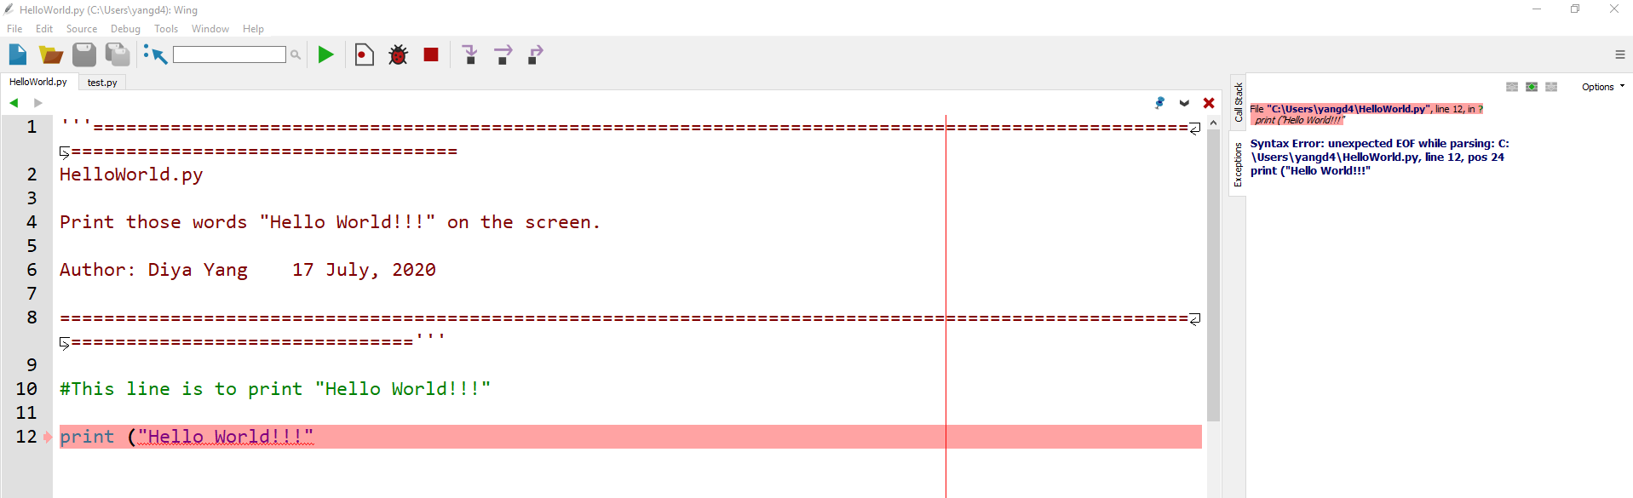
Basic Python
Debugging Option
Click on the button if your code doesn’t run
Hints and comments would be shown on the right side.

Slide 30
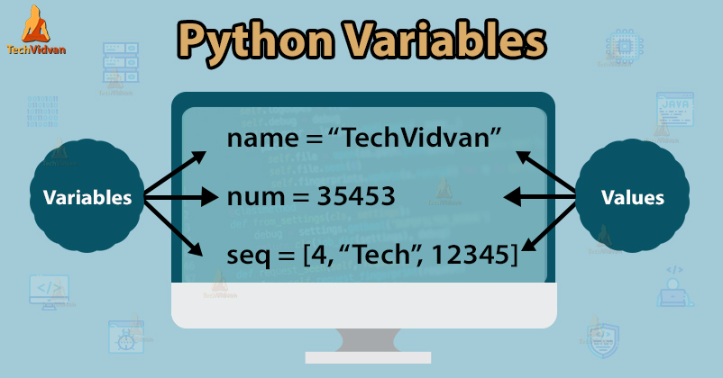
Variables

Slide 31
Basic Python
Variables
Define a Variable
A variable is a value that you can change and access throughout your script (variables are just names)
Variable names can only contain these characters:
Lowercase letters (a through z)
Uppercase letters (A through Z)
Digits (0 through 9)
Underscore (_)
Names cannot begin with a digit
1
1a
1_

Slide 32
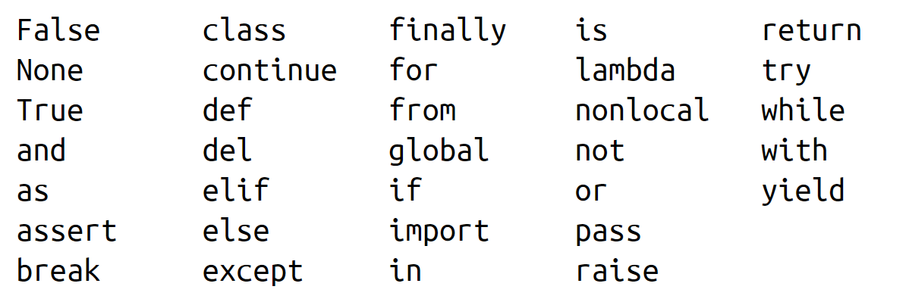
Basic Python
Variables
Define a Variable
Pick variable names that are distinctive and memorable
course = 'Python 101'
dnaseq = 'ATGCCTGAG'
num = 100
Don’t use any of these for variable names, because they are Python’s reserved words!

Slide 33
Basic Python
Basic variable types
Integer numbers
100
Floating point numbers
3.1415926
Strings
A sequence of zero or more characters that are enclosed within either a pair of single quotes or a pair of double quotes. String is immutable.
A string can include letters, digits, punctuation, white spaces and other characters (Eg. dnaseq = 'ANTGCTG’ )
Boolean
True
False
There is also a special no-value value called None (When the value is None, nothing is printed, since None means “nothing“)
>>> print ('single quote')
single quote
>>> print (''double quote'')
double quote
>>> print ('''triple single quote''')
triple single quote
>>> print (''''''triple double quote”””)
triple double quote

Slide 34
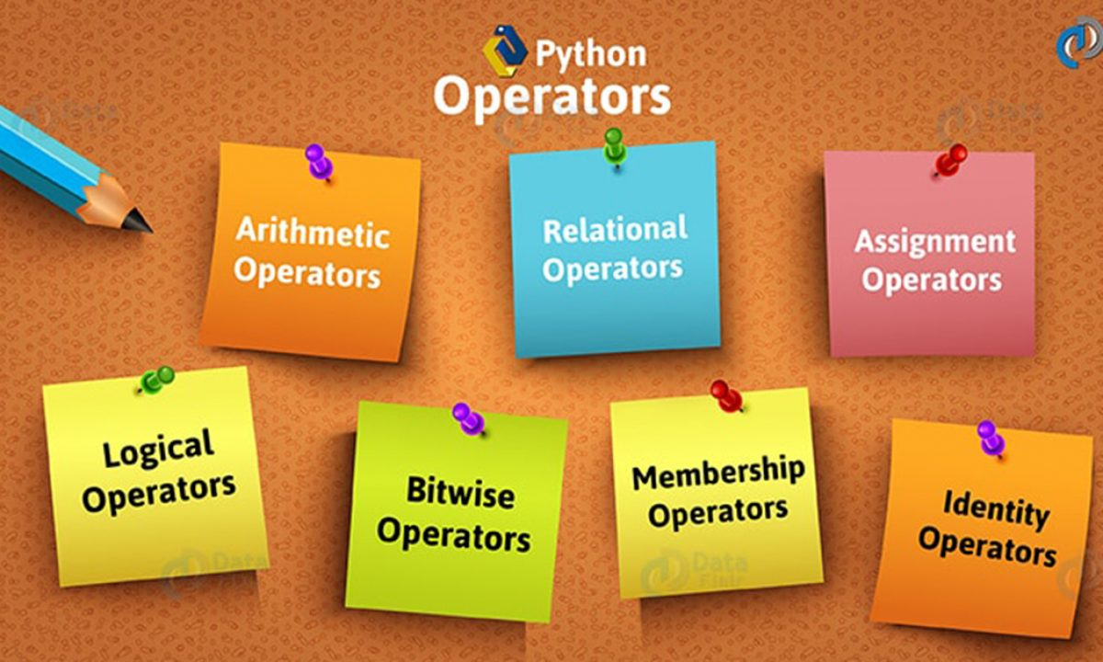
Operators

Slide 35
Basic Python
Operators
An operator is a symbol that indicates a calculation using one or more operands.
Numeric Operator
Operator | Description | Example
+ Addition | Adds values on either side of the operator | >>> 5 + 2 7
- Subtraction | Subtracts right hand operand from left hand operand | >>> 5 – 2 3
* Multiplication | Multiplies values on either side of the operator | >>> 5 * 2 10
/ Division | Divides left hand operand by right hand operand | >>> 5 / 2 2.5
// Integer Division | The whole number smaller than the floating point result | >>> 5 // 2 2
% Modulus | Integer remainder after b/a | >>> 5 % 2 1
** Exponent | Performs exponential (power) calculation on operators | >>> 5 ** 2 25

Slide 36
Basic Python
Operators
Numeric Operator
Operator | Description | Example
= | Assigns values from right side expression to left side operand | c = a + b assigns c the values of a + b
+= Add AND | It adds right operand to the left operand and assign the result to left operand | c += a is equivalent to c = c + a c += 1 is equivalent to c = c + 1
-= Subtract AND | It subtracts right operand to the left operand and assign the result to left operand | c -= a is equivalent to c = c - a
*= Subtract AND | It multiplies right operand to the left operand and assign the result to left operand | c *= a is equivalent to c = c * a
/= Divide AND | It divides left operand to the right operand and assign the result to left operand | c /= a is equivalent to c = c / a
//= Integer Division AND | It performs floor division on operators and assign value to the left operand | c //= a is equivalent to c = c // a
%= Modulus AND | It takes modulus using two operands and assign the result to left operand | c %= a is equivalent to c = c % a
** Exponent | Performs exponential (power) calculation on operators and assign value to the left operand | c **= a is equivalent to c = c ** a

Slide 37
Basic Python
Operators
Box Model
Beginning programmers are often puzzled by syntax such as
b = 2
b = 4 + b
print (b)
BEFORE you run this, what do you think the answer is?

Slide 38
Basic Python
Operators
Box Model
Beginning programmers are often puzzled by syntax such as
b = 2
b = 4 + b
Think of variables as boxes
a box is a location in memory
the variable name is a label on the box, or the name of the box if you like
b = 2 copies a value from a temporary location into the box
tmp
tmp
2
2
b = 2
b
b
2

Slide 39
Basic Python
Operators
Box Model
Think of variables as boxes
b = 2
b = 4 + b
4 is loaded in a temporary space
b is added to 2 in the temporary space
the result is copied back into b
tmp
tmp
4
2 + 4
6
4 +b
b = 4 + b
b
2
b
2
b
6
tmp = 4 +b
b = tmp

Slide 40
Basic Python
Operators
Box Model
The box model is conceptual
You can check where the variable is stored using the id() function
>>> n = 6
>>> id (n)
1349663056
>>> n += 4
>>> n
10
>>> id (n)
1349663120
When I change the value of n, its memory address changes
4 is loaded in a temporary space
>>> x = 2
>>> y = x
>>> y += 1
x =? y =?
x = 2 y = 3
Does not change x!!!

Slide 41
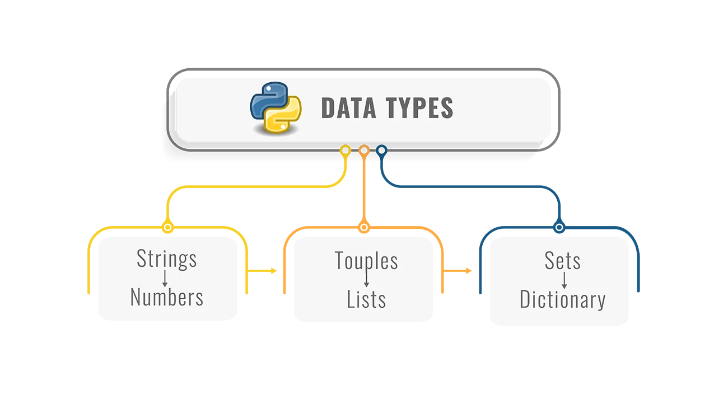
Convert Data Types

Slide 42
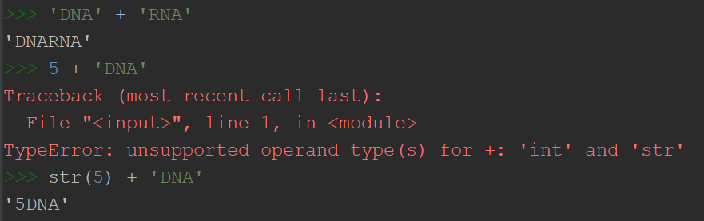
Basic Python
Convert Data Types
Type Conversions with int(), float() and str()
int() – Convert other data types to integer
Convert Boolean “True” and “False” to integer 1 and 0
Convert a floating-point number to an integer just lops off everything after the decimal point
float() – Covert a string or integer to a floating point number
Convert an integer to a float just makes it the proud possessor of a decimal point
Convert a string containing characters to a real float
str() -- Convert other data types to strings

Slide 43
Basic Python
Strings
String Index
Extract a character with [ ]
The first character is at position 0, not 1 (Remember!!!)
>>> dnaseq = 'ANTGCTG'
>>> dnaseq[0]
A
>>> dnaseq[1]
N
The index can also be negative. The last character is at index -1
>>> dnaseq = 'ANTGCTG'
>>> dnaseq[-1]
G
>>> dnaseq[-2]
T
0
1
2
3
4
5
6
-7
-6
-5
-4
-3
-2
-1

Slide 44
Basic Python
Strings
String Slicing [start:end:step]
Slicing extracts a series of characters from a string
The character positions of a slice are specified by two or three integers inside square brackets, separated by colons
0
1
2
3
4
5
6
>>> dnaseq = 'ANTGCTG'
>>> dnaseq[1:4]
NTG
-7
-6
-5
-4
-3
-2
-1
The second index indicates where the slice ends. The character at that position is not included in the slice!!!
The first index indicates the position of the first character to be extracted.

Slide 45
Basic Python
Strings
String Slicing [start:end:step]
A third number indicates a number of characters to skip, known as a step
0
1
2
3
4
5
6
>>> dnaseq = 'ANTGCTG’
>>> dnaseq[0:6:2]
ATC
-7
-6
-5
-4
-3
-2
-1
When the third number is omitted, as it often is, the default is 1
Negative step takes characters in reverse order
>>> dnaseq[6:0:-2]
GCT

Slide 46
Basic Python
Strings
String Functions and Methods
A function is a piece of code written to carry out a specified task, and called by name.
print() and input()
int(), float() and str()
Get length with len()
DNASeq = 'ANTGCTG'
DNASeq_length = len(DNASeq)
print(DNASeq_length)
7

Slide 47
Basic Python
Strings
String Methods
str.count() – count how many times a particular substring occurs in a string
dnaseq = 'ANTGCTG'
print(dnaseq.count('A')) # 1
str.replace(old, new, count) – replace a particular substring occurs in a string
dnaseq = 'ANTGCTG'
print(dnaseq.replace('N', 'G')) # AGTGCTG
str.lower() – return a copy of the string with all the cased characters converted to lowercase.
dnaseq = 'ANTGCTG'
print(dnaseq.lower()) # antgctg
dnaseq = 'antgctg'
print(dnaseq.upper()) #ANTGCTG
str.upper()

Slide 48
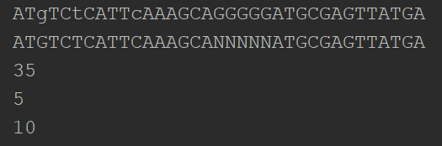
Basic Python
In Class Exercise
dnaseq = "ATgTCtCATTcAAAGCANNNNNATGCGAGTTATGA",
Write a simple python script to…
Replace “N” into “G” in the variable dnaseq, and print the sequence.
Capitalize all the lowercase in the variable dnaseq, and print the sequence.
Get the length of dnaseq and print the length.
Calculate the number of “G” and print the number.
Calculate the number of “G” in the replaced sequences and print the number.
Hints:
Write docstrings and comments.
Use .replace string method.
Use .upper string method.
Use len() function.
Use .count string method.
Expected results

Slide 49
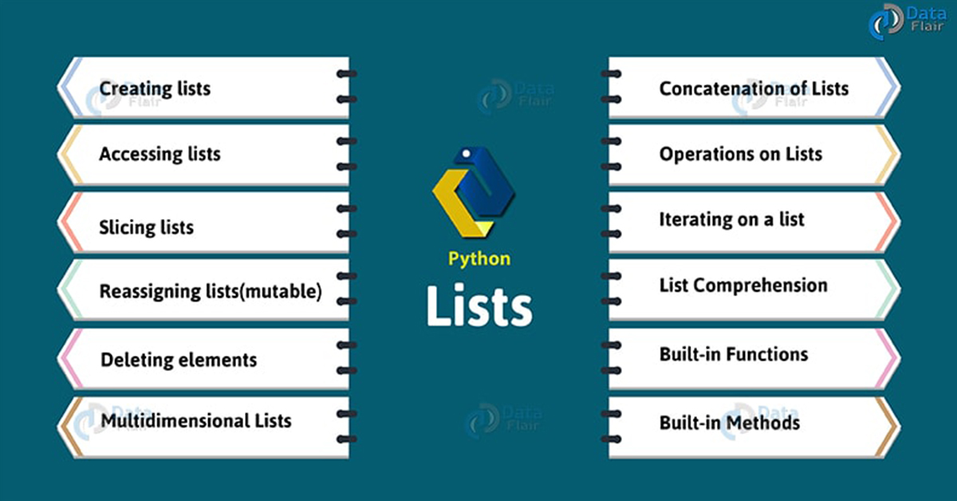
List

Slide 50
Lists
What is a List?
A list is made from zero or more items, separated by commas, and surrounded by square brackets.
>>> empty_list = [ ]
>>> weekdays = ['Monday', 'Tuesday', 'Wednesday', 'Thursday', 'Friday']
>>> birds = ['emu', 'ostrich', 'cassowary']
>>> first_names = ['Graham', 'John', 'Terry', 'Terry', 'Michael']
Items can be any data type.
>>> my_list = [123, 'John', 'Terry', 1.23]

Slide 51
Lists
How to Access List Elements or Items?
As with strings, you can extract a single value from a list by specifying its offset.
0
1
2
>>> sequences = ['AAA', 'TTT', 'GGG']
>>> sequences[0]
'AAA'
>>> sequences[1]
'TTT'
>>> sequences[2]
'GGG'
-3
-2
-1
>>> sequences[-1]
'GGG'
>>> sequences[-2]
'TTT'
>>> sequences[-3]
'AAA'

Slide 52

Lists
Change an Item by [offset]
Lists are mutable.
Strings are immutable
>>> sequences = ['AAA', 'TTT', 'GGG']
>>> sequences[2] = 'CCC'
>>> sequences
['AAA', 'TTT', 'CCC']
>>> DNASeq = 'ANTGCTG'
>>> DNASeq[1] = 'G'
>>> sequences = ['AAA', 'TTT', 'GGG']
>>> sequences[3] = 'CCC'
>>> sequences += ['CCC’] (or sequences.append['CCC’])
>>> sequences
['AAA', 'TTT', 'GGG', 'CCC']
IndexError: list assignment index out of range

